Slide 1
The New Modern Application Platform Session 6: Kubernetes Networking
“Bridging the growing chasm between developers and infra engineering”
Andy Tauber, Staff TAM
Dave Mazur, Staff TAM
January 2021

Slide 2
Today’s Class
Kubernetes Networking Overview
Architecture Review
Container-to-Container Networking
Pod-to-Pod Networking
Services
DNS
Ingress
Service Mesh
Network Policy
Container Network Interface (CNI)

Slide 3
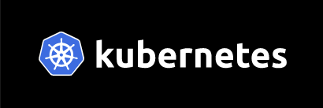
Kubernetes 1.21 GA
Immutable Secrets and ConfigMaps
By default, Secrets and ConfigMaps can be modified
Mutating ca cause problems if a bad configuration is pushed to pods
You can now mark Secrets and ConfigMaps as immutable
Ensures your application config will not change
To change, create new Secret/ConfigMap and deploy a new pod to consume that resource
PersistentVolume Health Monitor
1.21 contains a new “alpha” feature which allows PVs to be monitored for health of the volume
Can mark the volume “unhealthy” and applications can stop r/w of data to a bad volume
More info here
https://kubernetes.io/blog/2021/04/08/kubernetes-1-21-release-announcement/

Slide 4
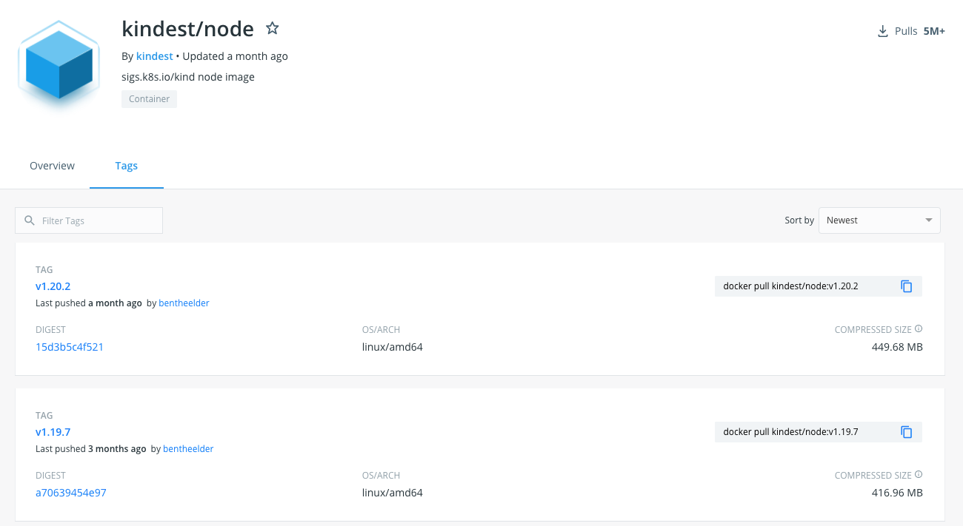
Kubernetes v1.21 + KIND
To use the v1.21 image with KIND (when it becomes available)
% kind create cluster –-image kindest/node:v1.21.0 –-name <add your cluster name here> --config kind-config.yaml
You can get the current Kubernetes image here:
https://hub.docker.com/r/kindest/node/tags?page=1&ordering=last_updated
Notes:
% kubectl get nodes (will show version number)

Slide 5
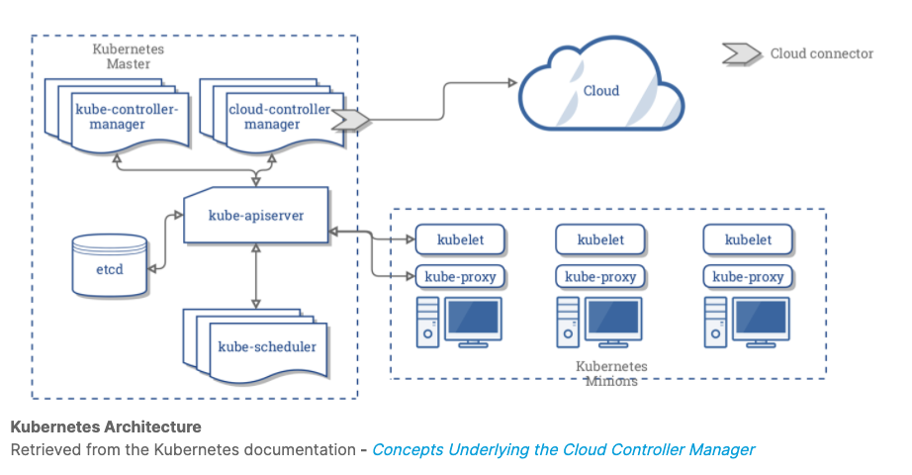
Kubernetes Architecture Review
With Respect To Networking
Every node running a container has a kubelet, docker daemon, and kube-proxy
Kube-proxy creates and manages networking rules to expose the container on the network
Node 1
Node 2
Node 3
Notes:
kube-proxy is a container in a pod in the kube-system namespace
Show this!
Kube-proxy manages the forwarding of traffic addressed to the virtual IPs of the clusters Service objects to the backend pods
% kubectl get nodes
% kubectl get pods -n kube-system

Slide 6
Kubernetes Network Requirements & Problems
Kubernetes has the following requirements on any network implementation
All Pods can communicate with all other Pods without using Network Address Translation (NAT)
All Nodes can communicate with all Pods without NAT
The IP that a Pod sees itself as is the same IP that others see it as
There are four networking problems to solve:
Container-to-Container networking
Pod-to-Pod networking
Pod-to-Service networking (Service)
Internet-to-Service networking (Service)
Notes:
A basic NAT is a simple mapping from one IP address to another.
NAT is used to map multiple private IP address into one publicly exposed IP address

Slide 7
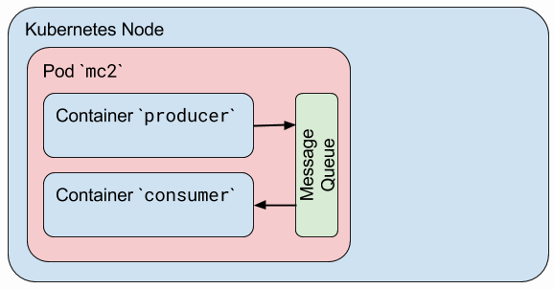
Container-to-Container Networking
The network assigns IP addresses to pods and needs to provide traffic routes between all pods on any nodes
Each Pod gets its own IP Address
The IP is set for the life of the pod
Pods can be treated much like VMs from the perspective of port allocation, naming, service discovery, etc
Containers in a pod share the same network namespace and the same IP address
IP addresses are assigned before the containers are started
Container-to-container communications within a pod
IPC (inter-process communication)
https://tanzu.vmware.com/content/rabbitmq/tanzu-rabbitmq-kubernetes
Loopback interface using localhost
Shared filesystem (including ConfigMaps)
NODE
Root Network Namespace
Eth0
POD 1 Network Namespace
POD 2 Network Namespace
Container 1
Container 2
Container 3
Container 4
Notes:
https://thenewstack.io/review-of-container-to-container-communications-in-kubernetes/
RabbitMQ for Tanzu
rabbitMQ deployed as cluster in kubernetes
Messaging broker
https://www.rabbitmq.com/features.html

Slide 8
Pod-to-Pod Networking - One Node
NODE
Root Network Namespace
eth0
Each Node has
Network interface – eth0
Root network namespace
Each Pod has
Own isolated network namespace
Own IP address
Pod namespaces are connected back to the root namespace with a virtual ethernet pair (veth0)
Pods are connected to each other and to the nodes eth0 interface via a bridge (br0)
The bridge works like a physical ethernet switch using either ARP (address resolution protocol) or IP-based routing
br0
veth01
veth02
POD 2 Network Namespace
POD 1 Network Namespace
eth0
eth0
Container 1
Container 2
Container 3
Container 4
Notes:
Let’s trace a packet from pod1 to pod2 now:
- pod1 creates a packet with pod2’s IP as its destination
- The packet travels over the virtual ethernet pair to the root network namespace
- The packet continues to the bridge br0
- Because the destination pod is on the same node, the bridge sends the packet to pod2’s virtual ethernet pair
the packet travels through the virtual ethernet pair, into pod2’s network namespace and the pod’s eth0 network interface

Slide 9
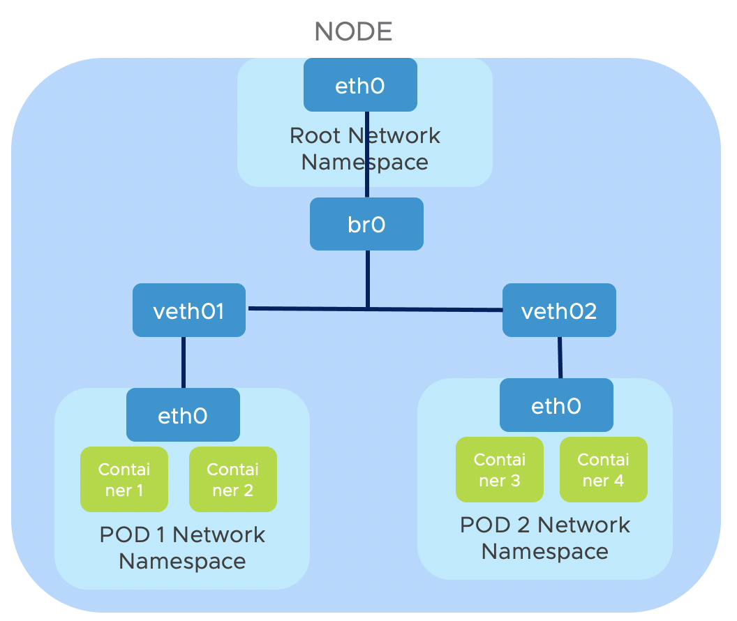
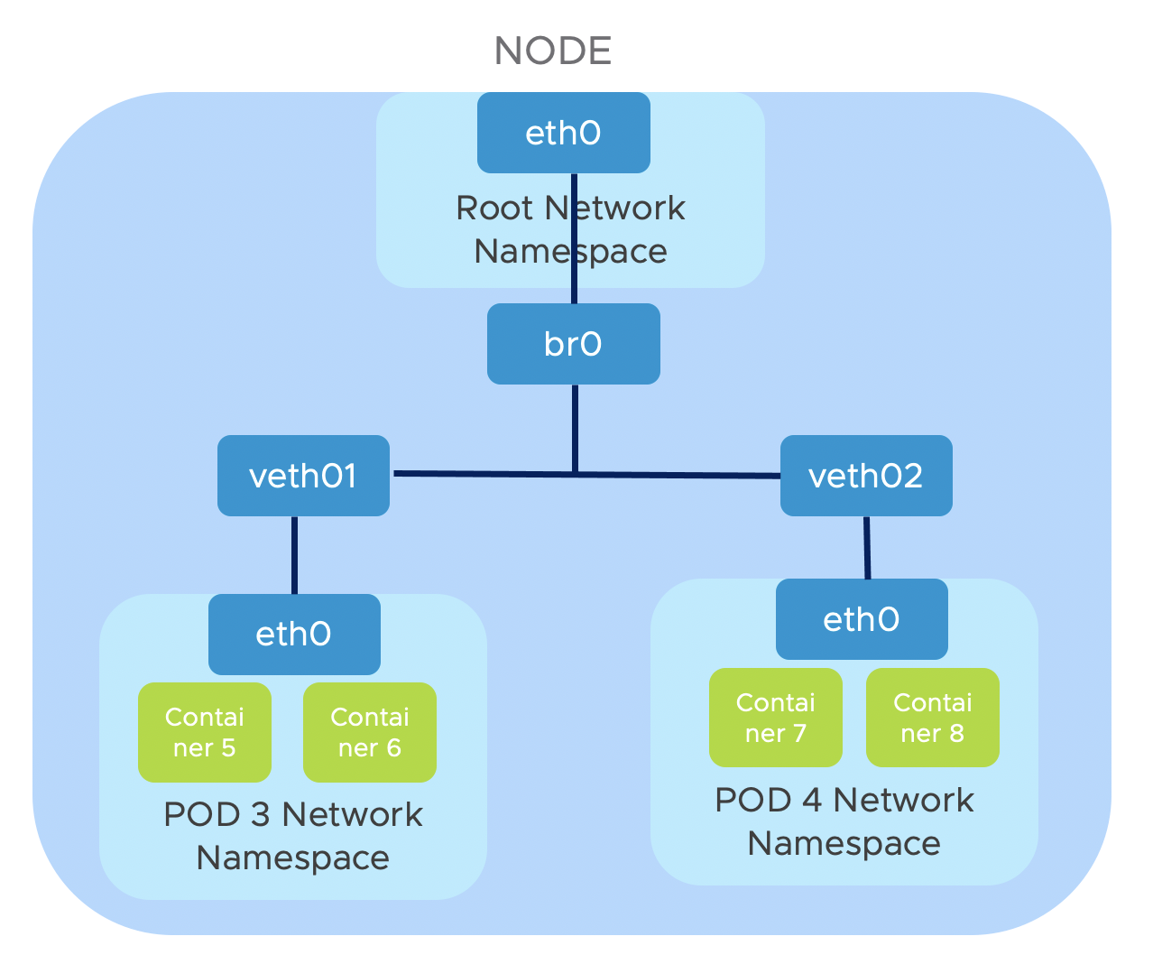
Pod-to-Pod Networking - Two Nodes
Each Pod in a cluster has a unique IP
Every Pod can communicate directly with all other Pods
Cluster Network
Notes:
Let’s trace a packet from pod1 to pod3 now:
- pod1 creates a packet with pod3’s IP as its destination
- The packet travels over the virtual ethernet pair to the root network namespace
- The packet continues to the bridge br0
- The bridge finds no local interface to route to, so the packet is sent out the default route toward eth0
Optional: if your cluster requires a network overlay to properly route packets to nodes, the packet may be encapsulated in a VXLAN packet (or other network virtualization technique) before heading to the network. Alternately, the network itself may be set up with the proper static routes, in which case the packet travels to eth0 and out the the network unaltered.
- The packet enters the cluster network and is routed to the correct node.
- The packet enters the destination node on eth0
Optional: if your packet was encapsulated, it will be de-encapsulated at this point
- The packet continues to the bridge br0
- The bridge routes the packet to the destination pod’s virtual ethernet pair
- The packet passes through the virtual ethernet pair to the pod’s eth0 interface

Slide 10
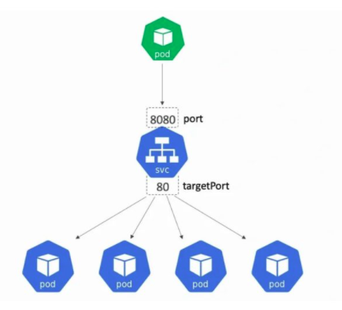
Pod-to-Service Networking
Because Pods can be moved, restarted, upgraded, it is difficult to send traffic via specific Pod IPs
Kubernetes introduces “Services” to help
Services are used to:
Connect pods together
Expose pods to the internet
Define pod access policy
When creating a service, Kubernetes provides:
DNS entry for each service’s name
Virtual IP (also known as a cluster IP)
Traffic addressed to the VIP will be load-balanced to the set of Pods associated with the Service
Kube-proxy maps virtual IPs to pod IPs within the cluster via iptables or IPVS (IP Virtual Server)
Notes:
a Service is an abstraction which defines a logical set of Pods and a policy by which to access them (sometimes this pattern is called a micro-service)
Service uses ClusterIP which is used to connect inside the cluster, not the IP of the cluster
IPVS – IP virtual server, runs on a host and acts as a load balancer in front of a cluster

Slide 11
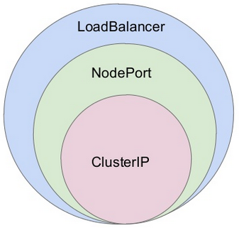
Services
Three types of Services:
ClusterIP – internal load balancer
NodePort – expose service on a specified port on each Node
LoadBalancer – expose service on external load balancer. This requires integration on the external network in order to dynamically bring up the load balancer. This is L4.
The following build on top of K8s services:
Ingress
ServicesMesh – Ingress with the addition of logical rules for traffic flow

Slide 12
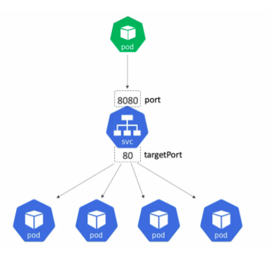
Cluster IP
Service Type
Default Service Type
Provides a stable IP and port that passes traffic to pods/containers on the same cluster
The stable IP and port are only accessible from other Pods running in the cluster
You specify two ports:
Port (8080 in the example on left)
TargetPort (80 in the example on left)
The top pod in green sends traffic to the other pods via port 8080. The service redirects that traffic to port 80 in the pods/containers
Notes:
https://nigelpoulton.com/explained-kubernetes-service-ports/

Slide 13
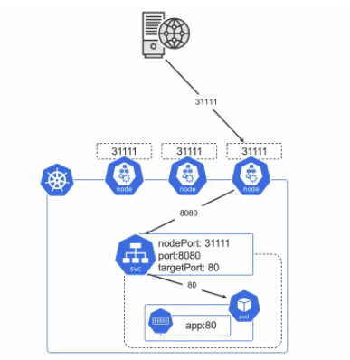
NodePort
Exposes an app to the outside world via a port mapping on every node in the cluster
In example, every node has the ”nodePort” 31111
You specify three ports:
- port
- targetPort
- nodePort
Any client outside the cluster can use port 31111 to access a node within the cluster and eventually reach pods/containers
Service Type
Notes:
https://nigelpoulton.com/explained-kubernetes-service-ports/

Slide 14
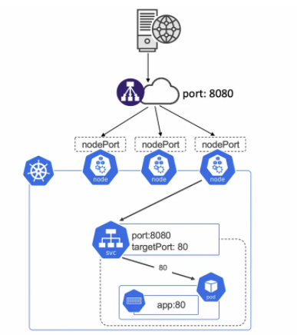
LoadBalancer
Builds on top of NodePort and Cluster IP
Exposes a service to the internet
Defines two ports:
Port
targetPort
Kubernetes works with your cloud APIs to create a load balancer
Traffic that comes into the load balancer on port 8080 is routed back to nodePorts (created by Kubernetes) and subsequently down to pods/containers
Service Type
Notes:
https://nigelpoulton.com/explained-kubernetes-service-ports/

Slide 15
coreDNS
coreDNS (KubeDNS was in earlier releases) resides in the kube-system namespace and provides internal Kubernetes DNS services
Services within a namespace are “local” in scope – only require short name. i.e. “curl invoice”
Services outside a namespace require full FQDN. i.e. “curl invoice.acme.svc.cluster.local”
Services take the naming format: {servicename}.{namespace}.svc.{cluster-domain}
Cluster-domain defaults to cluster.local
Any DNS name resolution requests that are not part of the cluster-domain gets sent to the node’s /etc/resolv.conf file for resolution – this is how requests to things outside the system like a Docker registry get resolved
NOTE: A service uses a port (i.e. service:port). You cannot use “ping” to access the service since ”ping” doesn’t use ports. You can use “curl” or “wget” instead
Notes:
Show coredns in the kube-system namespace
% kubectl get pods -n kube-system

Slide 16
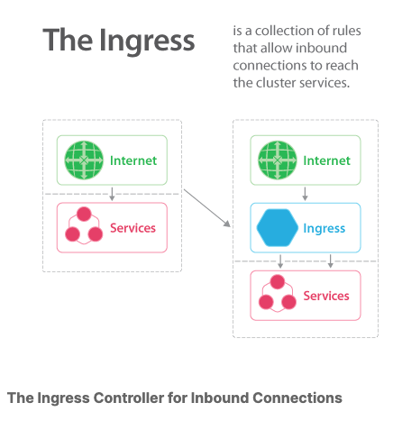
Ingress
An Ingress Controller is a daemon running in a POD
Allows inbound connections to a service (most often HTTP traffic)
You can deploy multiple ingress controllers
NGINX is an example of an ingress controller
$ kubectl get ingress
$ kubectl delete ingress <ingress_name>
$ kubectl edit ingress <ingress_name>

Slide 17
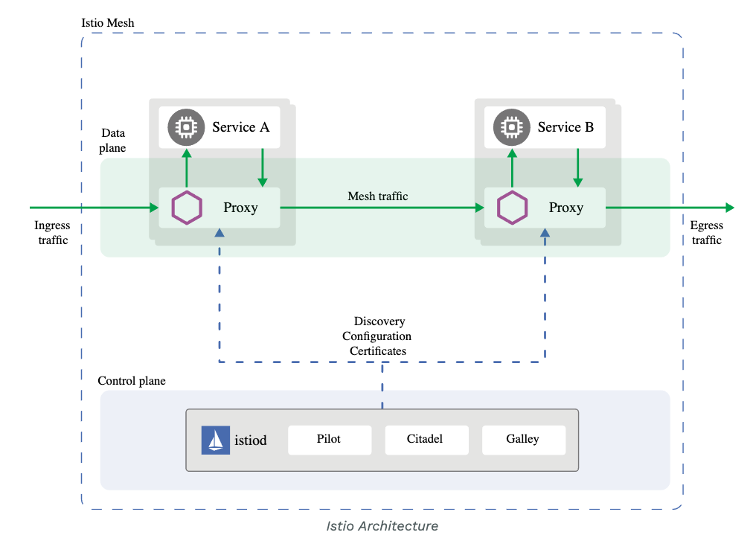
Service Mesh
For more complex connections or resources such as service discovery, rate limiting, traffic management and advanced metrics, you may want to implement a service mesh
A service mesh consists of edge and embedded proxies communicating with each other and handling traffic based on rules from a control plane. Various options are available, including Envoy, Istio, and linkerd
Istio is used in Tanzu Service Mesh (TSM)
Notes:
https://istio.io/latest/docs/concepts/what-is-istio/
#install instructions
https://istio.io/latest/docs/setup/getting-started/
#traffic routing
https://istio.io/latest/docs/tasks/traffic-management/

Slide 18
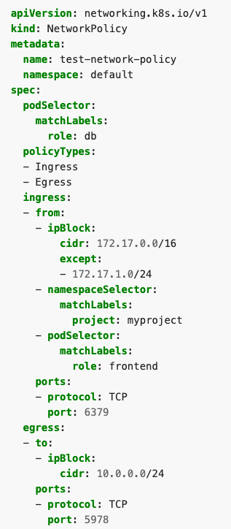
Network Policies
Used to control traffic flow at the IP or Port level within the cluster
Must be supported by the CNI
Pods become isolated by having a network policy that selects them
Communication specified by 3 identifiers:
Other pods that are allowed (podSelector)
Namespaces that are allowed (namespaceSelector)
IP Blocks (ipBlock)
Network policies could be used to isolate projects in a multi-tenant K8s cluster. A simpler solution might be to create smaller, single purpose clusters.
Notes:
https://kubernetes.io/docs/concepts/services-networking/network-policies/

Slide 19



Kubernetes Network Setup
Big Gotcha! Kubernetes comes without a network by default
To get a fully functional Kubernetes cluster, the network will have to be setup using one of the available options (next slide)
Default networks for KIND:
- KIND ships with a simple networking implementation (“kindnetd”) based around standard CNI plugins (ptp, host-local, …) and simple netlink routes.
- You may disable the default to install a different CNI. This is a power user feature with limited support, but many common CNI manifests are known to work, e.g. Calico.

Slide 20
Container Network Interfaces (CNI)
CNIs are networking plug-ins for Kubernetes – Kubernetes does not provide any default network implementation, rather it only defines the model and leaves other tools to implement it.
Calico
A flat Layer 3 network which communicates without IP encapsulation, used in production with software such as Kubernetes, OpenShift, Docker
For more details, check out the Project Calico web page
Flannel
Focused on traffic between hosts, not how containers configure local networking, it can use one of several backend mechanisms, such as VXLAN
You can learn more about Flannel from their GitHub page
WeaveNet
It is typically used as an add-on for a CNI-enabled Kubernetes cluster
To learn more, check out the Weave Net web page
Antrea: Vmware’s open source CNI solution - https://antrea.io/
Notes:
Adding example of Antrea+KIND in lab

Slide 21
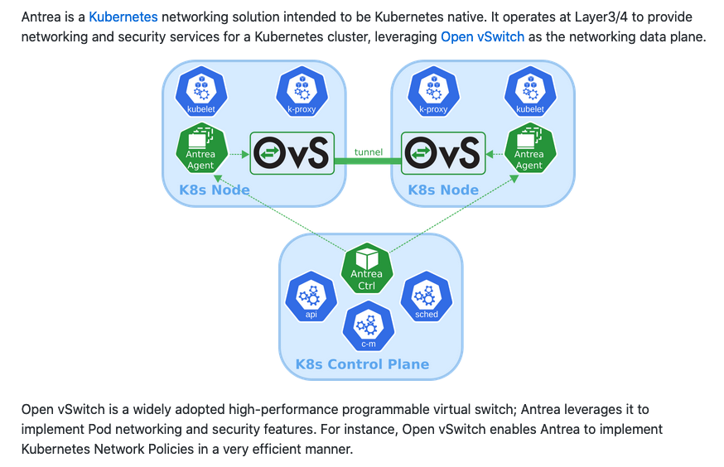
K8s Networking Overview
VMware Antrea CNI project (used in TKG vSphere with Kubernetes)
Notes:
You can implement Calico or Antrea in KIND!

Slide 22
K8s Networking – ClusterIP and NodePort Demo
Our networking options are limited in a home lab environment
Recreate kind cluster using new kind-config.yaml
This forwards two ports through the docker network so they can be accessed on localhost. This is a work around for running the K8s nodes as docker containers and used to access a NodePort.
In a ”normal” K8s environment where nodes are VMs, NodePorts would automatically become available on each K8s node.
ClusterIP demo
NodePort demo

Slide 23
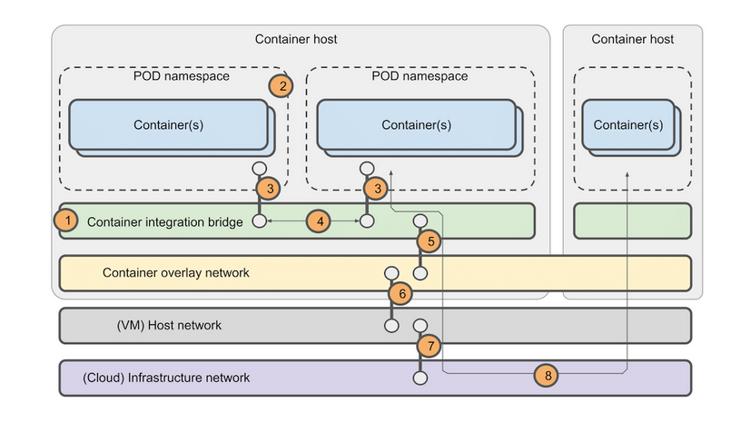
K8s Networking Overview
Overlay Network
Notes:
Diagram from: https://www.praqma.com/stories/debugging-kubernetes-networking/
One area not mentioned: service network

Slide 24
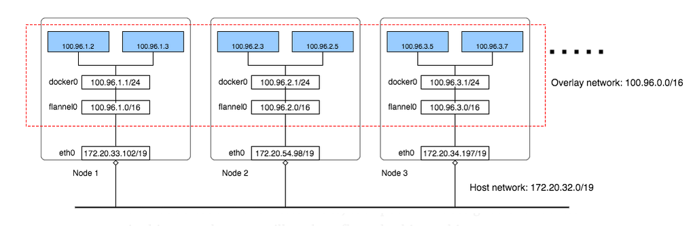
K8s Networking Overview
Overlay Network – using flannel CNI
Notes:
Diagram from: https://blog.laputa.io/kubernetes-flannel-networking-6a1cb1f8ec7c

Slide 25
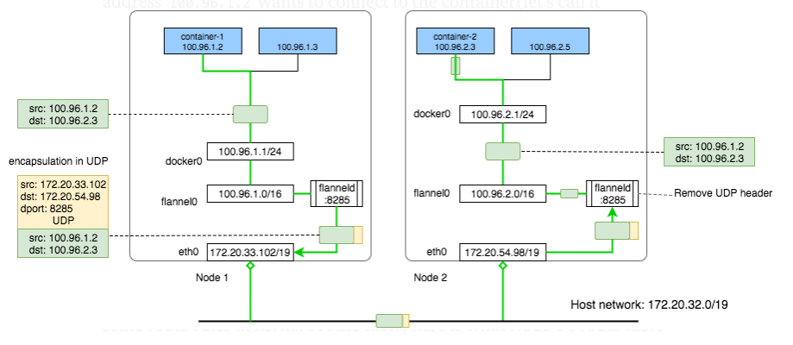
K8s Networking Overview
Overlay Network – flannel CNI cross host communication
Notes:
Diagram from: https://blog.laputa.io/kubernetes-flannel-networking-6a1cb1f8ec7c

Slide 26
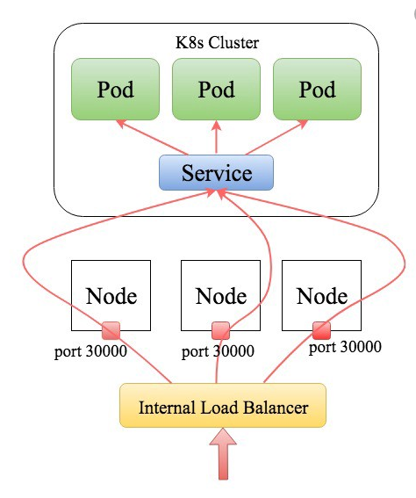
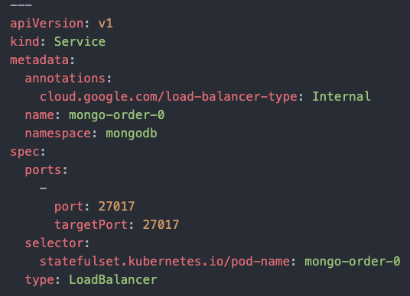
Challenges of Networking in an On-prem environment
LoadBalancer Example
A service of type: LoadBalancer creates a L4 Load Balancer used to access an app.
All artifacts must be created dynamically. We don’t want to manually create:
NodePort port number
External L4 Load Balancer appliance
Load Balancer IP address
In EKS or GKE, specifying a Service of type: LoadBalancer automatically does all of that
This works well when using a git repo of source code deployed by a ci/cd engine. We don’t need to assign specifics.

Slide 27
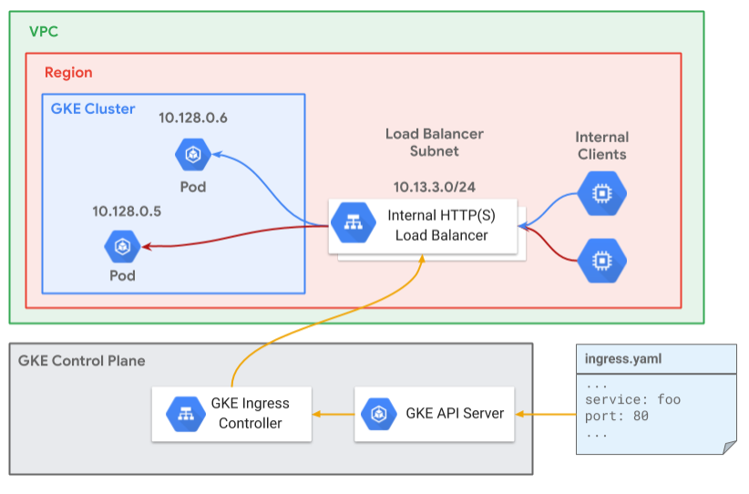
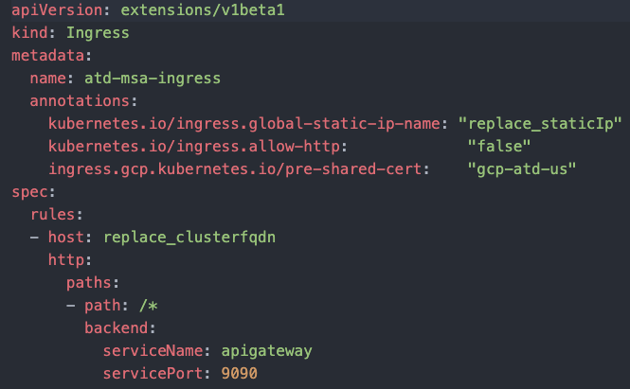
Challenges of Networking in an On-prem environment
Ingress Example
A kind of type: Ingress creates a L7 Load Balancer used to access an app or multiple apps in the cluster.
All artifacts must be created dynamically. We don’t want to manually create:
NodePort port number
External L7 Ingress Load Balancer appliance
Load Balancer IP address
FQDN DNS entry
Certificate
In EKS or GKE, there are functions provided for DNS, IP allocation, and certificates that can be called by the ci/cd engine

